Slide 1
MODELLING DEEP LEARNING NETWORK FOR VEHICLE IDENTIFICATION PROBLEM
MUHMMAD NIDZAM BIN MASO’OD
MAN171043
SUPERVISOR : DR. MOHD SYAHID BIN MOHD ANUAR

Slide 2

CONTENT
INTRODUCTION
BACKGROUND OF PROBLEM
PROBLEM STATEMENT
RESEARCH OBJECTIVES, RESEARCH QUESTIONS, DATA COLLECTION AND DATA ANALYSIS
LITERATURE REVIEW SUMMARY
RESEARCH METHODOLOGY FRAMEWORK
INITIAL FINDING

Slide 3
INTRODUCTION
Deep Learning application in image recognition has been popular for the past few years since the breakthrough of Convolutional Neural Network (CNN) by Yann LeCun with the introduction of LeNet (Y. LeCun, 1998)
Advances in computing power enable data to be process faster. As an example, the recent advancement of GPU (Graphical Processing Unit) with highly threaded parallel computing processors manage to achieve higher processing speed compared with CPU (Boyer & Baz, 2013).
Machine learning framework such as Tensorflow (Abadi, et al., 2016), PyTorch (Ketkar, 2017), Keras (Keras Documentation, n.d.), and MXNet (Chen, et al., 2015) helped to speed up machine learning development and also can help to scale the machine learning to production with ease.
New concept in CNN such as transfer learning (Hussain M. a., 2018) and pre-trained model helped to reduce the amount of data and shorten the time needed for CNN model training

Slide 4
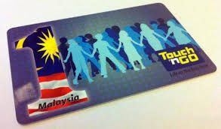
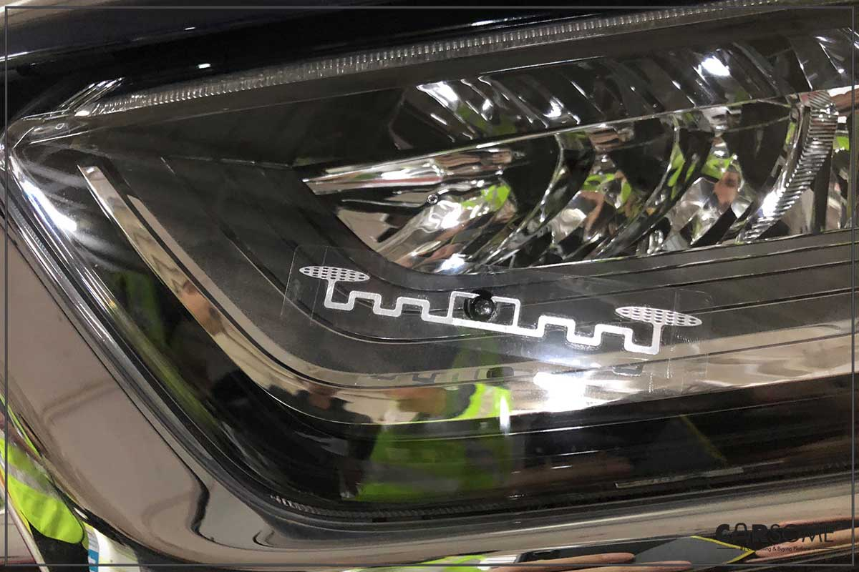
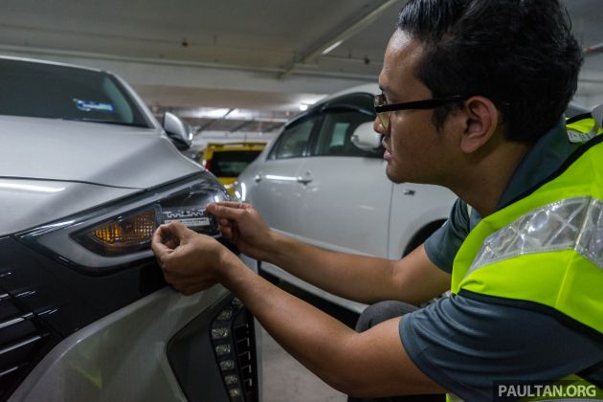
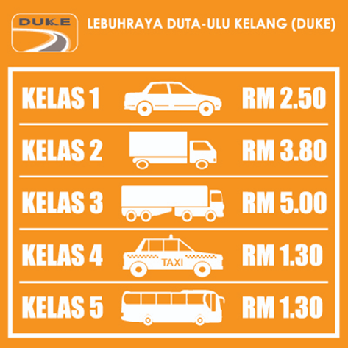
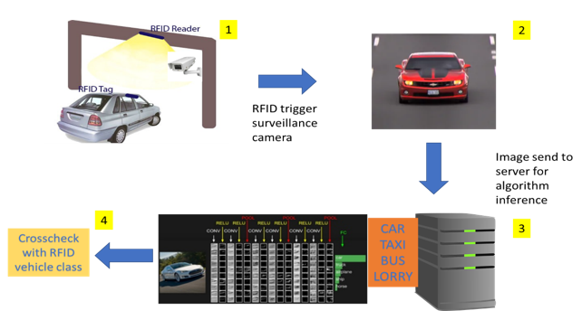
BACKGROUND OF PROBLEM
Implementation of RFID sticker expected to be implemented by Jan 2019
A fraudulent checking system based on vehicles type identification is proposed
However, this sticker can easily misused and put at other class of vehicles
RFID sticker is being placed at the headlamp of the car
The fare is different according to the class of the vehicle.

Slide 5
PROBLEM STATEMENT
various localized features of vehicles in Malaysia
accuracy of the detection
fraudulent cross-checking system using visual recognition
speed of the inference time to cater for high speed movement of the vehicles on expressway
An enhancement of CNN by manipulating the number of filter and layer and implementing on GPU to produce better accuracy and improve processing time

Slide 6
RESEARCH OBJECTIVES, RESEARCH QUESTIONS,
DATA COLLECTION & DATA ANALYSIS
Research Objectives | Research Question | Data Collection | Data Analysis
To propose a suitable model of CNN to obtain better accuracy | What is the CNN architecture that give better accuracy | Accuracy of unseen sample for different CNN architecture | Compare accuracy between CNN architecture (Faster RCNN, SSD and YOLO)
To improve the processing time by implementing the CNN model on GPU | How to run CNN model on GPU | Processing time between CPU and GPU | Compare the processing time between CPU and GPU
To evaluate the performance of the proposed model by comparing with other selected CNN architecture | How to evaluate the performance of the proposed model by comparing with other selected CNN architectures | Collect the performance data between CNN architectures | Metric measurements (mean Average Precision and processing time in seconds, s)

Slide 7
RESEARCH OBJECTIVES, RESEARCH QUESTIONS,
DATA COLLECTION & DATA ANALYSIS
Research Objectives | Research Question | Data Collection | Data Analysis | Expected outcome
To identify a suitable model of CNN which able in obtaining better accuracy for our proposed vehicle proposed visual recognition system. | What is the CNN architecture that give better accuracy | Accuracy of unseen sample for different CNN architecture | Compare accuracy between CNN architecture (Faster RCNN, SSD and YOLO) | Identified algorithm selection for experiment.
To develop or improve CNN model on GPU which able to improve the processing time for proposed vehicle proposed visual recognition system. | How to run CNN model on GPU | Processing time between CPU and GPU | Compare the processing time between CPU and GPU | Optimized selected algorithm
To evaluate the performance of the proposed model by comparing with other selected CNN architecture | How to evaluate the performance of the proposed model by comparing with other selected CNN architectures | Collect the performance data between CNN architectures | Metric measurements (mean Average Precision and processing time in seconds, s) | Best algorithm selection for proposed vehicle proposed visual recognition system.

Slide 8
SCOPE AND LIMITATION
SCOPE AND LIMITATION
This research will only focus on the CNN architecture and technique used to speed up process and that can reduce training sample required for CNN training.
Sample used for this training are images collected from the Internet. Total sample size 448 images. The images are split into two folders. 90 images in the test folder and the rest of the images in training folder.
For object classification, the research will classify cars (class 1), lorries (class 2 and class3), taxis (class 4) and busses (class 5).

Slide 9
LITERATURE REVIEW SUMMARY
Author | Model | Findings
(Y. LeCun, 1998) | LeNet-5 | Introduce CNN with 7 layers for handwritten and machine-printed character recognition
(Krizhevsky A. a., 2012) | AlexNet | Introduce deeper and larger CNN compared to CNN with 8 layers. The last 3 layers are fc layers. ReLu used as activation function.
(Zeiler & Fergus, 2014) | ZF Net | Enhancement to AlexNet by tweaking the hyperparameter such as expanding middle convolutional layer and making stride and filter size on the first layer smaller.
(Szegedy, Toshev, & Erhan, 2013) | GoogLeNet | Introduces Inception module which reduce the number of parameters in the CNN network. This architecture also uses Average pooling rather Max pooling thus further reducing number of parameters

Slide 10
Author | Model | Findings
(Simonyan & Zisserman, 2015) | VGGNet | Use only 3x3 convolution and 2x2 pooling throughout the network thus giving deeper depth and result. It proves depth of the network plays an important role
(He, Zhang, Ren, & Sun, 2016) | ReSNet | Introduce Residual block which solved the degradation problems which occurs as the network depth increases (accuracy get saturate and degrades rapidly)
(Girshick, Donahue, Darrell, & Malik, 2014) | R-CNN | Selective search to extract 2000 regions (region proposals) from image. Region proposal generated using selective search algorithm. This architecture cannot be used in real time and required huge amount of training time. Learning process did not happen using selective search causing bad candidate region proposals generation.
(Girshick, Fast R-CNN, 2015) | Fast R-CNN | Input image is feed into CNN to generate convolutional feature map rather than using region proposal. Region proposal identified from convolutional feature map. This process is done once per image making it faster than R-CNN

Slide 11
Author | Model | Findings
(Ren, 2015) | Faster R-CNN | Introduces separate network to predict the region proposals and eliminates the usage of selective search algorithm thus making faster than R-CNN and Fast R-CNN.
(Liu, et al., 2016) | SSD | Eliminates the usage of region proposal thus speeding up the process. To prevent drop-in accuracy, SSD applies multi-scale feature and default boxes. Does not works very well detecting small object.
(Redmon, 2016) | YOLO | Use a single convolutional network to predicts the bounding boxes and class probabilities for these boxes. YOLO however is having some difficulties in detecting small objects within the image due to the spatial constraints of the algorithm.

Slide 12
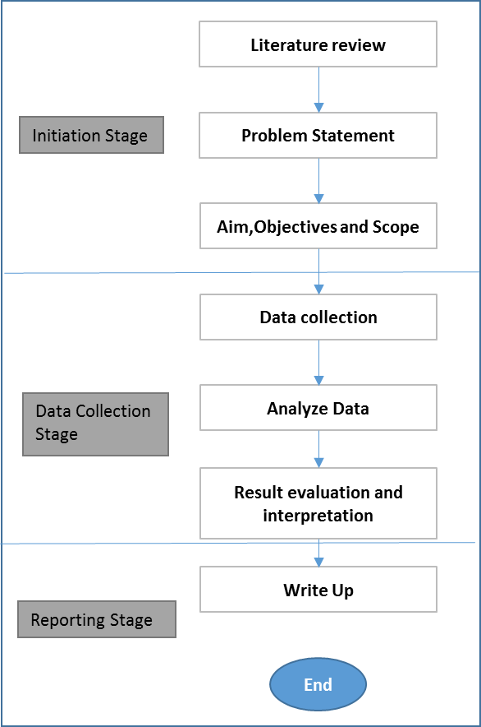
RESEARCH METHODOLOGHY FRAMEWORK
Tools and Platforms
In this study, the computation tool specification that we will be using is as below
Windows edition: Windows 10 Home
Processor: Intel® Core™ i5-7200U CPU @ 2.50GHz 2.71 GHz
Installed memory (RAM): 12.00GB
System type: 64-bit Operating System, x64 bit processor
GPU: GeForce 940MX
In this study, we will be using Tensorflow as the machine learning framework
d) Metric selection
This project will focus on the accuracy of the classifier and time taken for inception since it will be used to monitor traffic movement on the expressway. For this project the metric that will be used are
mAP (mean Average Precision): metric to measure the accuracy of object detectors.
Processing time: time taken for processing the data
Study phases
Phase 1: Based on the labelled images, we can run the object detection algorithm and get the initial result. To validate the result, samples have been divided into training samples (358 samples) and test samples (90samples).
Phase 2: In the second phase, we will select the best object detection algorithm based on the experiment result and apply it into our application and run it in real environment.
Initiation stage
problem statement
research objective & question
Scope
literature review
CNN architectures
CNN common architecture
Object detection framework
transfer learning
Summary of the literature review
d) Data collection stage
Data (images) for this project have been collected from the internet. Specific keyword has been used to search for the images are as below:
• Car
• Lorry
• Taxi
• Bus
• Taxi Malaysia
• Lorry Malaysia
• Bus Malaysia
• Highway CCTV
All images have been labelled using labelImg software and details of the object location within the images are stored into xml format file.
Data collection stage
a) Data sampling
sample size 448 images
train: 358 images
test: 90 images
2 unseen samples from car, taxi, lorry and bus from actual expressway surveillance camera will be used to gage the algorithm performance (mAP and inference time).
b) Algorithm Selection
Faster R-CNN
SDD
YOLO
c) Feature Selection
Selected images contain images of bus, lorry, taxi, and car. Effort have been made to select images with localized features

Slide 13
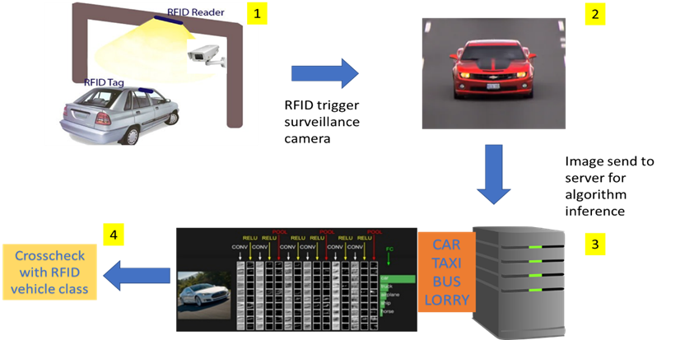
INITIAL FINDINGS
Initial Finding
Proposed fraudulent cross-checking system

Slide 14

Experiment environment setup
ANACONDA installation
NVDIA CUDA and cuDNN installation
TensorFlow installation:
CPU and GPU
Activate the environment and install TensorFlow
Install necessary packages for both virtual environments
Download TensorFlow Object Detection API repository from GitHub
Download the algorithm model from TensorFlow's model zoo
Configure PYTHONPATH environment variable
Compile Protobufs
Create a different virtual environment for TensorFlow CPU and TensorFlow GPU
run setup.py

Slide 15
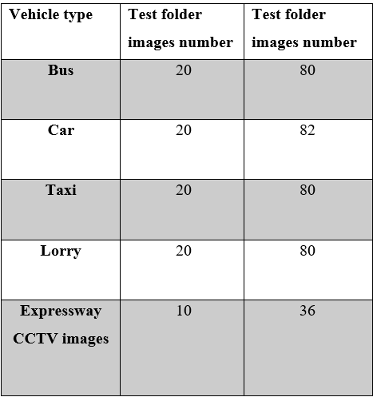
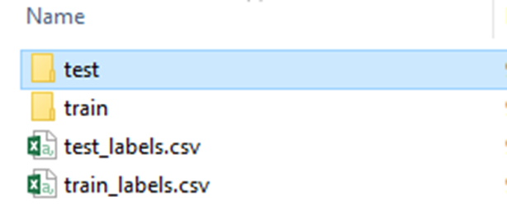
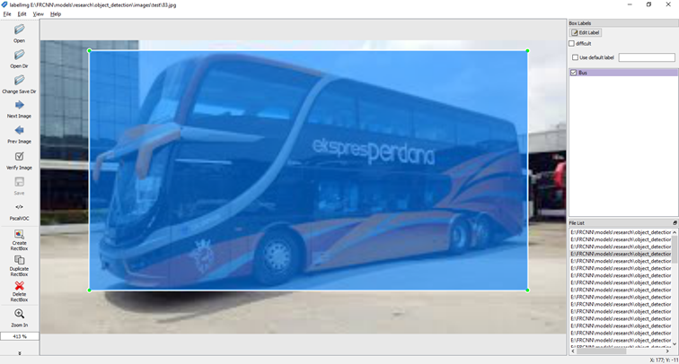
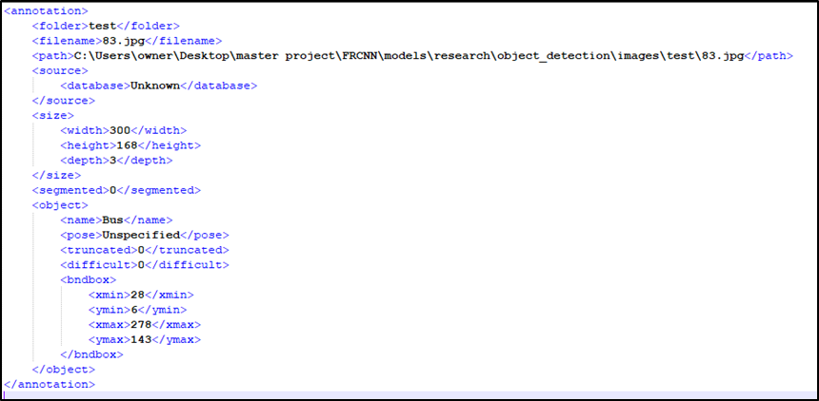
Data pre-processing
448 samples images have been collected then split into test and train inside models\research\object_detection\images directory
The xml file is then compiled for both test and train folder using [ python xml_to_csv.p] run from \object_detection folder
annotate the image using labelImg program
When image is saved, the program will create an xml file.

Slide 16
Conclusion
PROBLEM | RESEARCH STAGE | OBJECTIVES | Cause | OUTCOME/PROPOSAL
Wrong vehicle class classification | Data collection stage | To correctly classify vehicles | Insufficient images samples with specific angles. | Added more samples with various angle
Cannot train data for SSD and YOLO | Data collection stage | To train data for SSD and YOLO | Insufficient memory (hardware limitation) | To study possibilities of using google COLAB for training. Inference process can be done using current hardware.

